Slide 1
Constant Gain Feedback Controller and On/Off Controller with Hysteresis

Slide 2
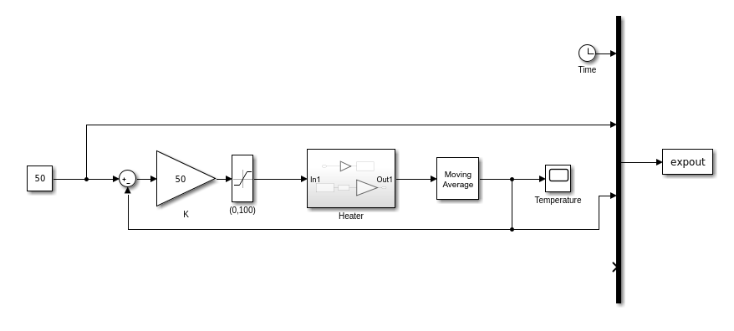
Constant Gain Feedback Controller

Slide 3
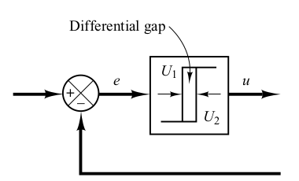
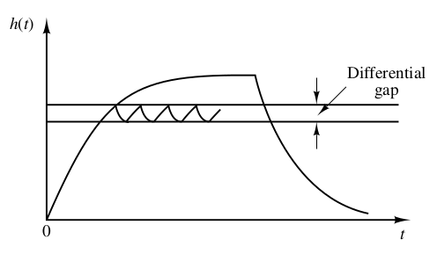
On/Off Controller with Hysteresis

